Slide 1
Act Early Response to COVID-19
Division of Early Childhood 2020 Annual Conference
January 29, 2021
Betsey Howe, PhD, AUCD/CDC Fellow
Karnesha Slaughter, MPH, Health Communication Specialist, CDC
The findings and conclusions in this report are those of the authors and do not necessarily represent the official position of the Centers for Disease Control and Prevention.

Slide 2
Objectives Session participants will:
Describe the “Learn the Signs. Act Early.” (LTSAE) program.
Identify and define the 4 steps of the LTSAE early identification model for young children with developmental disabilities including autism.
Describe components of the Act Early Response to COVID-19 Project.
Identify key early childhood programs across the sectors of the early childhood system who are partners and implementors of system change related to LTSAE goals.
Describe the different strategies being utilized by the Act Early Response teams for integrating LTSAE materials into high-reach, key early childhood programs to reach underserved communities and improve family resiliency during the current pandemic.

Slide 3
Agenda
Overview of CDC’s “Learn the Signs. Act Early.” (LTSAE)
The Early Identification Model
The Act Early Response to COVID-19 Project
Question and Answer

Slide 4
“Learn the Signs. Act Early.” (LTSAE) & Early Identification of Young Children with Developmental Disabilities, Including Autism

Slide 5
Why “Learn the Signs. Act Early.”?
About 1 in 54 children has autism spectrum disorder (Maenner et al., 2020)
About 1 in 6 children aged 3-17 has a developmental disability (Zablotsky et al., 2019)
ASD can be diagnosed as early as 18 months, yet the average age for ASD diagnosis is > 4 years of age (Maenner et al., 2020)
Many children do not benefit from early intervention; for example, in one study only 10% of children received services by 24 months (Rosenberg, Zhang, & Robinson, 2008)

Slide 6
"Learn the Signs. Act Early." Mission http://www.cdc.gov/ActEarly
To improve early identification of developmental delays and disabilities, including autism, by increasing parent-engaged developmental monitoring so children and their families can get the early services and support they need.
www.cdc.gov/ActEarly

Slide 7
Simply put…
Helping parents and other care providers learn the signs of typical development and act early on concerns.
-----------------------------------------
Signs of typical development=
MILESTONES
Act Early=
Talk with the doctor, ask for screening.
Get referral to specialist and connect with early intervention.

Slide 8
What is Early Identification?
Parent-Engaged Developmental Monitoring
Developmental & Autism Screening
Referral for Services
Receipt of Early Intervention Services

Slide 9
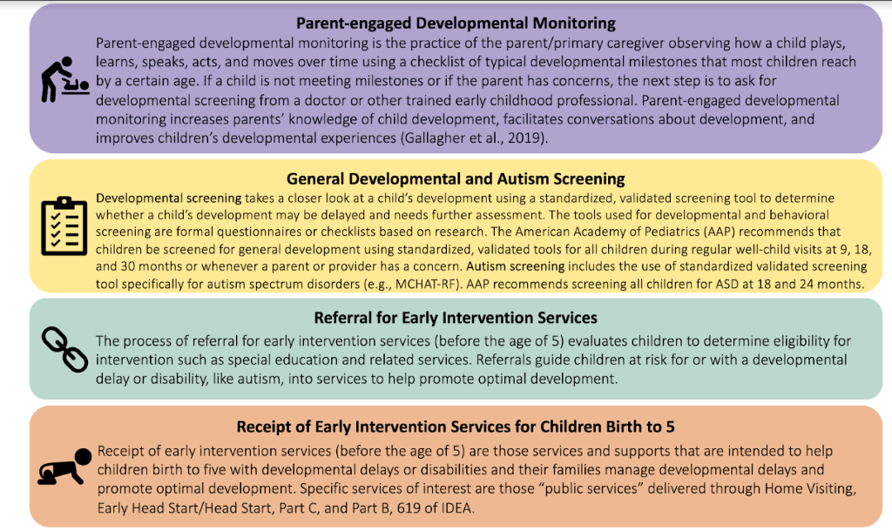
The 4-Steps of Early Identification

Slide 10
Campaign Strategy: Integrating Parent-Engaged Developmental Monitoring
Integrate parent-engaged developmental monitoring using LTSAE milestone checklists into national, state, and local programs that
Serve parents of young children
Serve low-income, disadvantaged populations
Have interest or mandate in child development
Lack tools/resources for helping parents track milestones or act on concerns

Slide 11
LTSAE Integration Framework
Level 1: Passive promotion of LTSAE materials
Level 2: Active distribution of LTSAE promotional materials
Level 3: Routine training of staff (e.g., using Watch Me!)
Level 4: Active distribution of LTSAE checklists
Level 5: Active completion of LTSAE checklists

Slide 12
The Act Early Response to COVID-19 Project

Slide 13
Scope:
Support early childhood state/territorial programs through the Act Early Network to target families most impacted by COVID-19 and promote resiliency for children, families, and communities
Purpose:
To bolster the 4 steps of early identification of developmental delays and disabilities using LTSAE and advance the promotion and distribution of tools, materials, and programs to improve resiliency among families with young children during COVID-19 response and mitigation efforts.
Project Scope and Purpose
Notes:
The support being provided for early childhood state systems through the Act Early Network is really to support COVID-19 response, mitigation, and recovery efforts by way of strengthening resilience skills, behaviors, and resources of children, families, and communities. Act Early Ambassadors are leading or co-leading their state/territorial teams. Act Early Ambassadors receive a very small stipend to serve as their state or territorial point of contact for the national Learn the Signs Act Early Program and promote the adoption and integration of these resources into systems that serve young children and families. This project represents an expansion of these efforts in many ways. The purpose of this project is to bolster the four steps of early integration (1) parent-engaged developmental monitoring, (2) developmental and autism screening, (3) referral, and (4) receipt of early intervention services for children birth to 5 during the pandemic with the ability to sustain.

Slide 14
Project Goals
Develop and coordinate an Act Early Ambassador-led (or co-led) state/territorial team.
Engage the state/territorial team in conducting a needs assessment to identify CURRENT (during COVID-19) barriers and opportunities related to the four key steps of early identification.
Develop, implement, and evaluate a work plan to address the identified barriers and realize the identified opportunities related to the first step AND any of the additional 3 steps of early identification.
Identify, implement, and evaluate strategies to improve resiliency of very young children (birth to age 5) and their families.
Notes:
The project goals are as follows and we want to highlight the fourth goal in particular-expanding strategies to promote family resiliency as intertwined with early identification given the strong association between familiy well-being and child development
Teams are asked to consider strategies and supports beyond LTSAE and early identification
E.g. supporting well-child visits, access to high quality childcare, developmental promotion, linkages to services (e.g., WIC) for family support, and
advancing the promotion and distribution of relevant, existing CDC and CDC Partner tools, materials, and programs to improve resiliency by addressing social determinants of health and promoting safe, stable and nurturing relationships among families with young children

Slide 15
Project Details
Federally funded by the CARES Act
A national endeavor and private/public partnership
$4M+ Awarded to 43 State and Territorial Teams
The cooperative agreement is from September 2020 to the end of August 2021
Each team creates work plans describing their activities to meet the project goals
Each team participates in 2 group TA calls per month and a 1:1 call per month

Slide 16
Goal 1: Response Team Partner Composition
Response Team Partners
Frequency of Early Childhood Programs
Named in RFA State Plans
At least 7 different key early childhood programs:
Title V
Part C
Help Me Grow (HMG)
Early Childhood Comprehensive Systems Impact Grant programs (ECCS)
American Academy of Pediatrics (AAP)
Disability Advocacy
At least one statewide high reach organization
Home Visiting
WIC
Child Welfare
Head Start Start/Early Head Start, Childcare
Notes:
Τηε μεαν νυμβερ οφ ΕΧ προγραμσ ναμεδ ασ παρτνερσ ον στατε ανδ τερριτορψ ρεσπονσε τεαμσ ιν τηε ωορκ πλανσ ισ 7.63 (ΣΔ = 1.76), ωιτη α μεδιαν οφ 7 ανδ α ρανγε οφ 4 το 11 παρτνερ προγραμσ.
Τηε μοστ φρεθυεντλψ ναμεδ παρτνερσ αρε Τιτλε ς (93%), ΙΔΕΑ Παρτ Χ (93%), ανδ Δισαβιλιτψ Αδϖοχαχψ Προγραμσ (93%). Φολλοωινγ τηεσε παρτνερσ αρε τηε ΑΑΠ (91%), Χηιλδχαρε (67%), ΗΣ/ΕΗΣ (63%), ανδ Ης (58%). Αδδιτιοναλ ναμεδ παρτνερσ αρε ΙΔΕΑ Παρτ Β, 619∗ (35%), ΩΙΧ (30%), ανδ Χηιλδ Ωελφαρε (30%).

Slide 17
Other Key Partners
Family advocacy organizations were named as partners for 81% of the state and territory teams
UCEDD/LENDS were documented in 65% of the plans, and autism programs in 35% of the plans.

Slide 18
Goal 1: Engage Stakeholder Team
Progress through December 2020
All state stakeholder teams have met at least one time since the start of the project
Teams reporting a high level of engagement and enthusiasm for the work compared to past efforts prior to COVID-19
States are using LTSAE materials to engage partners
Notes:
NY: Use of LTSAE integration framework and spotlight on “Promising Practices” on CDC website led to partner buy-in to work with ambassador to create individualized action plan
OK: Use of LTSAE and Watch Me! at stakeholder meeting led to commitment from partners to include LTSAE messaging on their websites

Slide 19
Goal 2: Needs Assessment
Purpose:
To conduct a rapid needs assessment (as outlined in RFA Goal 2) to quickly gain an understanding of the current and emerging strengths, needs, barriers, and opportunities related to the 4 steps of early identification of developmental delays among children birth to 5 during COVID-19, across early childhood systems and programs.
Parent-engaged developmental monitoring
Developmental and autism screening
Referral for early intervention services
Receipt of early intervention services for children birth to 5, across early childhood systems

Slide 20
Goal 2: Needs Assessment
1 Team Lead Survey- 76 Team Leads Invited
1 Partner Survey- 647 Partners Invited
N = 392 Surveys completed
Team Lead Survey | Partner Survey
Administered and disseminated by CDC/AUCD | Administered and disseminated by CDC/AUCD, with introductions and reminders shared by team leads
Completed by Act Early Response to COVID-19 team leads | Completed by the representatives of key partner programs and systems listed on response teams’ workplans serving children birth to 5 (e.g., Part C, WIC, Home Visiting, Early Head Start)
Gathered overall state/territory information related to the 4 steps of early identification | Gathers specific early childhood program and system information related to the four steps of early identification

Slide 21
Goal 2: Needs Assessment
State teams are also conducting their own needs assessments to better understand the needs of families and/or providers related to COVID-19, early identification, and resiliency
State teams are also using other sources of data from other needs assessment such as those done by home visiting, PDG, or Title V, to understand the context of their state and the needs of their families
Notes:
Focus Groups with Families: CT, DC
Focus Groups with Providers: MA
Surveys of Families: CT, DC, MS
Surveys of Providers/Programs; MD

Slide 22
Goal 3: Integration of LTSAE into at least one high reach program.
Notes:
Programs housed within the Bureau of Maternal and Child Health (MCH) are named the most often (63%) as a target of integration for LTSAE materials in the state teams' work plans. MCH programs include HV (19, 44%), Title V (6, 14%), and CYSHCN (2, 5%). Following MCH programs are HS/EHS (56%) and Childcare (37%). Other programs named as a target of LTSAE material integration are HMG (28%), Part C (26%), WIC (23%), Primary Care Physicians (23%), Child Welfare (16%), and Part B, 619 (9%).
Most states are focused on level 3, 4 , and 5 of the integration framework with State and territory teams indicated level 5 integration of LTSAE materials in 16% of the plans, level 4 in 26% of the plans, and level 3 in an additional 26% of plans.

Slide 23
System Focus of Team’s Integration Work
Notes:
Across the 43 work plans, 12% have a healthcare focus, 12% have an education focus, and 76% focus on both healthcare and education.

Slide 24
Goal 3: What Does Integration Look Like Across the Teams?
States are providing early childhood programs with a range of integration options across the levels of the framework
Promotional materials are being distributed in innovative places such as through library systems and bus stops/stations
Training is occurring using both CDC’s Watch Me! and team developed trainings
Technology is being used to find ways to support families to complete checklists virtually
Teams are including materials related to family resiliency as part of their distribution of LTSAE
Notes:
INTEGRATION OPTIONS:
Allows states to draw programs into the work and expose them to LTSAE. Meets programs needs.
TRAINING
Training topics included the four steps of early identification (8), using LTSAE materials (6) such as the Watch Me! Celebrating Milestones and Sharing Concerns training modules, the Milestone Tracker Application and Books, Balls, and Blocks. (See Figure 5.)
Training descriptions also included different components, such as extending training beyond a single event (13). Examples of extended training include follow-up support, coaching, TA, community of practices or learning communities, training the trainer or parent trainer models, and using an Extension for Community Healthcare Outcomes (ECHO) model.
Description of training components also included ways LTSAE could be illustrated (8), such as webinars, power points, and presentations.
Some plans described strategies for ongoing use of training such as archiving for future use, providing narrated power points, and developing manuals or modules.
Audiences benefitting from training activities included personnel across the education sector such as Head Start and childcare providers, primary care physicians, medical and allied health profession students, and families.

Slide 25
Goal 3: Innovative Implementation Efforts
Grassroots efforts are focusing on how to use local/community level implementation to achieve a state-wide reach
Focus on systems and policy around early identification to support more seamless experiences for families
Opportunities for teams to collaborate and share resources across states
Notes:
TX deputy ambassadors
OH promotoras
AR parent navigators
Pilot sites to demonstrate implementation: MA (WIC), OK (HS), MT (ECE)
POLICY
NH single point of entry for families
VT
TRAINING
3 state teams (VA, WY, OH) are working collaboratively to design a shared ECHO

Slide 26
Goal 3: High Needs Populations
Notes:
State and territory team included a focus on children and families living in poverty in 33% of the plans, while a focus on populations by specific race (e.g., Hispanic, Marshallese) was noted in 26% of the plans, and children and families living in hard to reach areas (rural, tribal) in 23% of the plans.

Slide 27
How are High Needs Populations Being Reached?
Collaborating with trusted community-based partners
Identifying barriers for access to service
Partnering with community-agencies to integrate LTSAE materials
PSAs using radio stations for different ethnic communities
Notes:
OR collaboration with community agency to reach migrant farm workers
UT Navajo community members
Ut South Main Street
WI using LEND trainees with community connections

Slide 28
Goal 4: Strategies to Improve Resiliency
HI: Using the Survey of Well-Being for Young Children to assess for resiliency needs
VT: Using a state-wide framework on resiliency developed with partners from across their early childhood system
NC: State-wide conference on infant and early childhood mental health for infant/toddler specialists
Notes:
State teams describe activities to support young children and families' resiliency as part of goal four of the RFA. Resiliency activities are those defined as including efforts to support families in adapting to changes that have occurred due to COVID-19 or other sources and reducing sources of stress by promoting resources to help families cope with new or existing burdens. Below is a summary of the different ways state teams described supporting family resiliency in their work plans.
Many of the work plans referenced using training (20*) to support building family resiliency. The types of training included the (ECHO) model (3), communities of practice (1), telehealth (3), and use of a parent mentor (1). Examples of named resiliency trainees include providers (2), families (2), and high needs populations (2). Designated training topics include recognizing signs of autism, Milestones Matter, protective factors for families, social detriments of health, use of the ASQ, and use of "Lemonade for Life," a resiliency curriculum.
Some (5) work plans also referenced the dissemination of materials to support building resiliency in families. The distribution of materials includes in places such as WIC, Libraries, Food Banks, Primary Care Physicians Offices, and Community Clinics. The types of materials described as being utilized to build resiliency in families include those from the CDC (8), LTSAE (10), Zero to Three (2), the Maternal and Child Health Bureau (2), and the Center for the Developing Child (2).
Plans also describe the use of different curriculums or tools (7) related to building resiliency, which includes Strengthening Families (AL, ID, KY, SC, UT), Be Well Indiana (IN), Resilient Vermont Messaging Tool Kit (VT), Big Life (OH), Let’s Play (OK), Lemonade for Life (NE), and the Center for the Study of Social Policy’s Protective Factors Framework (SC, AL). Some (7) plans did not provide specific information regarding specific materials for building resiliency.

Slide 29
Questions?

Slide 30
Act Early Response to COVID-19
Betsey Howe ehowe@aucd.org
Karnesha Slaughter lio8@cdc.gov
The findings and conclusions in this report are those of the authors and do not necessarily represent the official position of the Centers for Disease Control and Prevention.

