Slide 1
MSM-OMH/HHS The National COVID-19 Resiliency Network (NCRN) Mitigating the Impact of COVID-19 on Vulnerable Populations
Vulnerable Communities
NCRN Dissemination Platform
Multi-Media/ Cultural/Linguistic Outreach to Diverse Communities
Develop National Partnership
Monitoring Evaluation and Quality Improvement
Link Communities to Healthcare and Social Services
Document and Disseminate Strategies/ Findings
Identify and Engage
Dominic H. Mack MD, MBA
Professor, Family Medicine
Director, NCPC
Morehouse School of Medicine

Slide 2
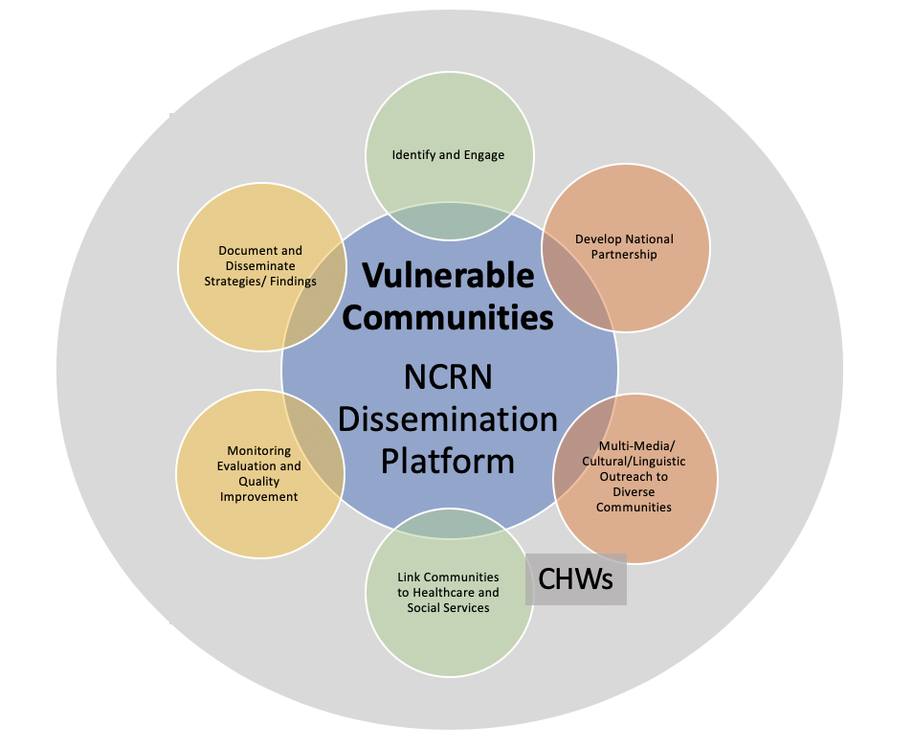
Goal: Mitigate the Impact of COVID-19 on Vulnerable Populations
Objectives
1) Identify and engage vulnerable communities through local, state, territory, tribes and national partners.
2) Nurture existing and develop new partnerships to ensure the NCRN is an active information dissemination network.
3) Partner with vulnerable communities and national, state, local, and government organizations to provide and disseminate culturally and linguistically appropriate information throughout states, territories, and tribes.
4) Use technology to link members of the priority vulnerable communities to community health workers, COVID-19 healthcare and social services, including testing, vaccinations, behavioral health counseling, and links to primary care practices.
5) Monitor and evaluate the success of the services and measure outcomes using process improvement methods to improve the quality of the overall program.
6) Use broad and comprehensive dissemination methods, including mainstream media, white papers, and publications as resources and strategies to add to the body of scientific knowledge and to bring awareness, participation, education and training.

Slide 3
The National COVID-19 Resiliency Network (NCRN)
Mitigating the Impact of COVID-19 on Vulnerable Populations
Technology Platform

Slide 4
Simply, the platform links:
ZIP CODE → RISK → CULTURE → TESTING → CARE

Slide 5
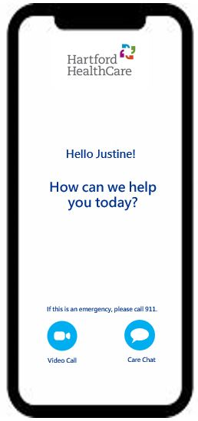
Accelerating Consumer Engagement Technologies
Leverage existing subject matter professionals to leverage key partnership and scale services in response to COVID-19
National COVID-19
Resiliency Network
Digital Presence
COVID-19 Digital triage process via web and mobile applications
Chat Bot
Symptom Checker, testing locator and general information inquiries to help drive consumers to the right channels for their needs.
Hello Sarah
Virtual-Collaboration
Provide a platform for public partnerships and organizations to collaborate and manage resources for individuals and communities at scale
Click HERE to start your
COVID-19 screening
Telco/Telehealth
Work with affiliated health system partners to offload volume of patient inquiries around testing, medication management, education, refills, etc.,
Outreach Services
Proactively reach out to individuals and communities with resource to assist with COVID-19 transportation needs to assist with coordination and delivery
Ability to deploy technology in multiple languages may be offered
Also state that appropriate federal and state privacy rules will be incorporated into the solution.
Notes:
KPMG assistance with the following:
Review of existing COVID-19 response methods / approach for leading practice knowledge sharing
Organizational alignment of processes and protocols
Workflows design and end-to-end testing, monitoring and optimization
Updates to digital presence to reflect COVID-19 response options (i.e., screening questionnaire)

Slide 6
Table 1. NCRN Five Priority Communities Impacted by COVID 19 (Phase 1)
State/Territory | # Cases | # Deaths | Priority Areas | Vulnerable Communities | Reasoning
Georgia | 1567 | 126 | Dougherty County | African American | 17 out of 1000 citizens are infected, health system overwhelmed, HPSA
Louisiana | 5724 | 61 | Orleans, Jefferson, East Baton Rouge Parishes | African American Incarcerated | Quick rise in cases and deaths, 2nd highest incarcerated population in US, need for culturally appropriate approach for African Americans
Navajo Nation | 2757 | 88 | Reservation touches Arizona, New Mexico, Utah | Native Indian | Largest American Indian population with the highest infection rate and most deaths; Need for additional culturally relevant resources, HPSA
New York | 340,442 | 25,585 | New York City | African American Hispanic Asian | Highest cases and deaths in US, risk of resurgence as state opens for business
Rural consortium Texas Alaska | 37,674 377 | 1,068 3 | Moore County Anchorage | Hispanic/Migrant workers Alaskan Native | TX-Meat Packing, 19 out of 1000 citizens being infected, HPSA Small numbers, but high underlying health risk and scarce healthcare availability, HPSA

Slide 7
NCRN Partnerships
National
Strategic Partners
Community
State OMH, Public Health
CHWs
State, Territory and Tribes
CBOs, Health Systems, Local Organizations
Partner Capabilities
Connection with Racial and Ethnic Groups
Reach/Breadth
Ability to Communicate with community
Boots on the Ground Capability (CHWs)
Existing Resources

Slide 8
Scope of Work Guidance
Identify and Engage- Identify and engage community- based partners to support NCRN objectives. Assist with the identification of ”hot spots” and areas of interest.
Partner- Co-branded partnership with NCRN. Introduction and assistance with additional community-based partnerships that will be valuable for outreach to community.
Messaging- Assist the NCRN team with current messaging and the development of new messaging for community.
Link- Marketing, collaboration with community programs and events, link to CHWs where appropiate.
Evaluate- Enter program activity into CRM tool, assist with collection of information and data relevant to program objectives.
Disseminate- Assist with dissemination of NCRN-related education programs and best practices. Lead or assist with the writing of white papers, scientific publications according to organizational capacity.

Slide 9
Thank YOU!

